Slide 1
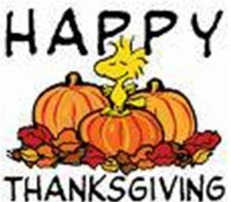
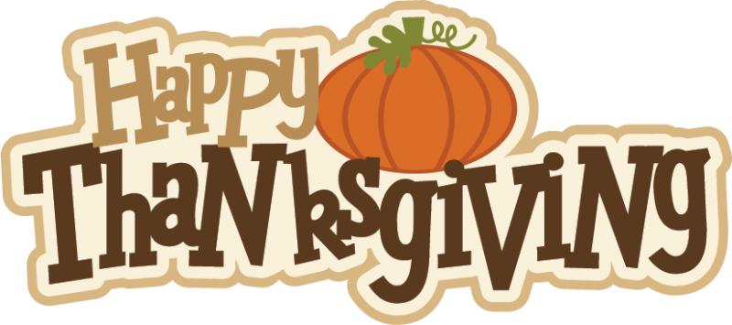
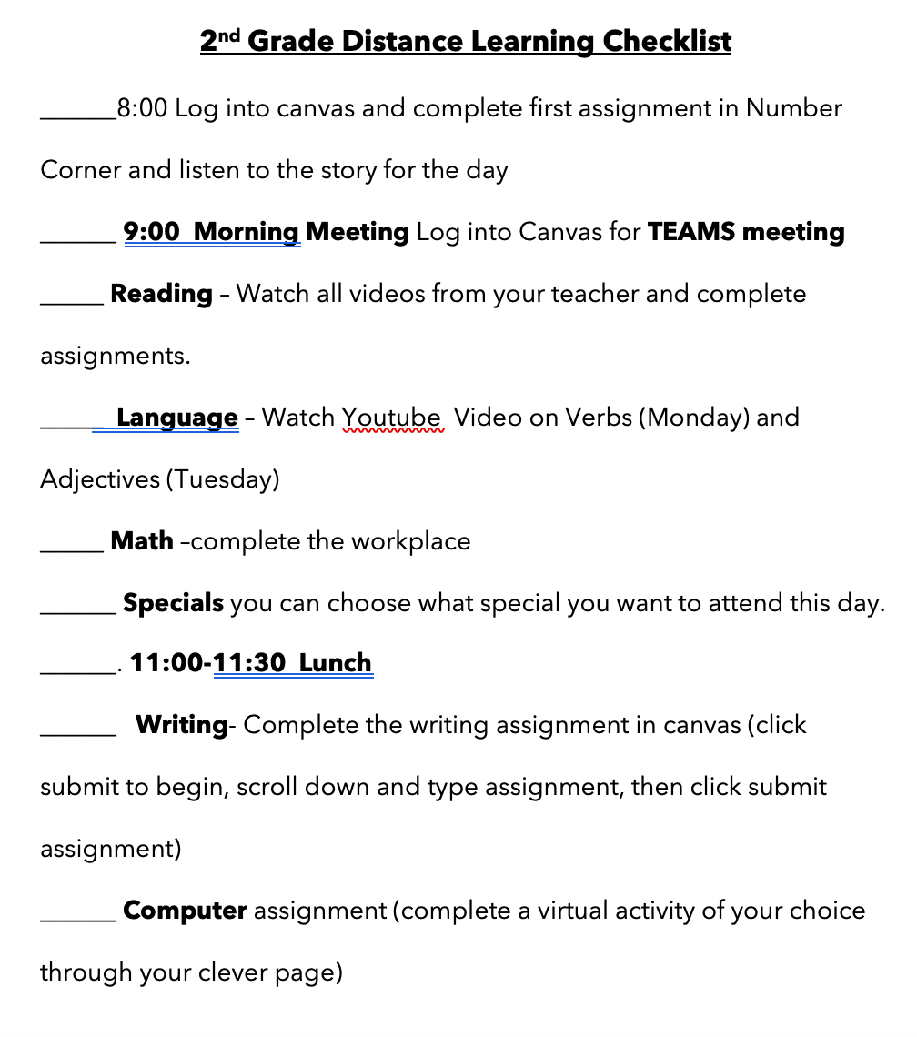
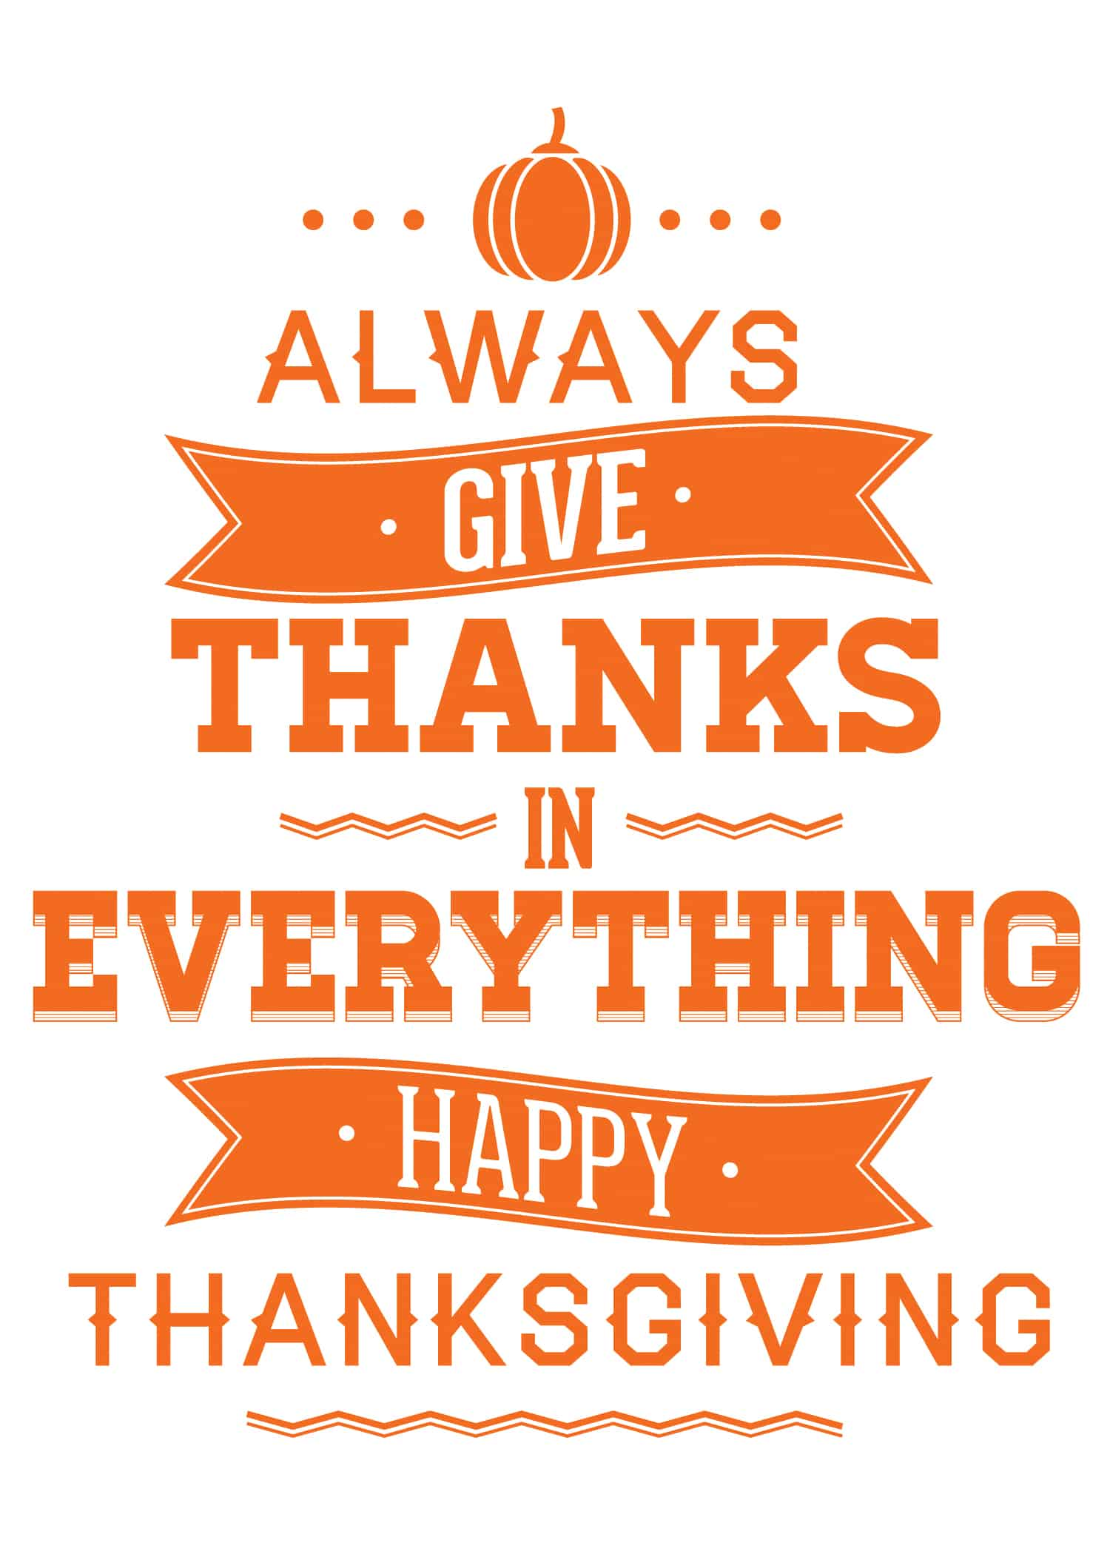
Second Grade News
November23rd and 24th
SPELLING
Ha ve a safe and happy Thanksgiving
No spelling
Reminders:
November 23rd and 24th are virtual school days. This day will be just like our last virtual day.
Tests this week:
This Photo by Unknown Author is licensed under CC BY-NC-ND

