Slide 1
Chapter 11

Slide 2
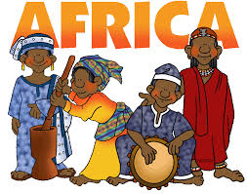

Slide 3
VOCABULARY
Migration: movement from one country or region to settle in another
Bantu: a large group of central and southern Africans who speak related languages
Savanna: an area of grassland with scattered trees and bushes
Sahara: a huge desert stretching across most of North Africa
Oral History: accounts of the past that people pass down by word of mouth
Clan: a group of families who traces their roots to the same ancestor

Slide 4
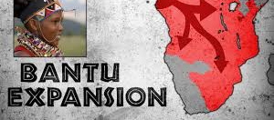
About 4,000 years ago, many families left where they lived in West Africa never to return and carrying everything they owned with them.
No one knows exactly why they first moved.
They kept searching for better land for farming.
Over time, their migration, or movement from one region to settle in another, took them across most of Africa south of the Equator.
Today, they have more than 200 million descendants.
The name Bantu describes both this large group of Africans and the related languages they speak.

Slide 5
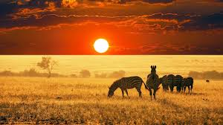
Africa’s Physical Geography
Africa consists of tropical rain forests that are located on both sides of the Equator.
They have hot, moist climates.
Surrounding these forests are bands of savanna, areas of grassland with scattered trees and bushes.
Africa’s lions, zebras, and elephants live mainly on the savannas.
Deserts stretch north and south of the savannas.
The Sahara is a desert stretching across most of North Africa and is the world’s largest desert.
A band of lakes, deep valleys, and rugged mountains runs north to south through East Africa.

Slide 6
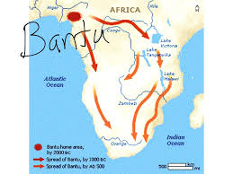
The Bantu Migrations
The physical barriers formed by lakes, forests, mountains, and rivers did not stop the movement of people across Africa.
These migrations continued for more than 1,000 years.
They are among the largest population movements in all of human history.

Slide 7
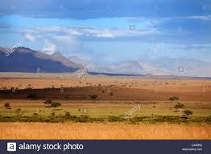
The History of Sub-Saharan Africa
Historians know a great deal about North Africa’s history, but have a sketchy knowledge of Africa’s history south of the Sahara – sub-Saharan Africa.
Today, scientists and historians are working to piece together the history of this area.
Learning about this area is difficult because the wood and clay that the Africans used for building have disintegrated.

Slide 8
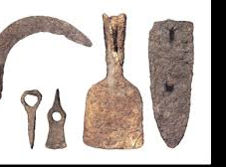
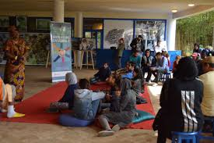
The History of Sub-Saharan Africa, cont.
Even iron tools and weapons have not lasted because iron rusts fairly quickly.
However, modern inventions have helped scientists uncover new information.
Stories told by traditional African storytellers have led to new areas of exploration.
These stories are often oral history, accounts of the past that people pass down by word of mouth.

Slide 9
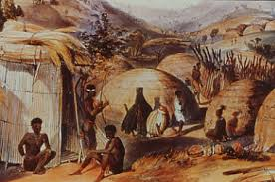
The Bantu
In early times, most Bantu-speaking people were fishers, farmers, and herders.
Their villages were made of people from the same clan, or group of families who traces their roots to the same ancestor.
Many of these clans traced their ancestry through mothers rather than fathers, so property and positions of power were passed down through the mother’s side of the family.
The Bantu-speaking people moved slowly from their traditional homelands in search for better farmland and better grazing.
As the Bantu migrated, they entered different environments and had to change the way they lived.

Slide 10
The Spread of Bantu Culture
Often, Bantu people moved into areas where other people already lived.
When this happened, they sometimes joined the other groups living there.
The other cultures then usually adapted to Bantu culture.
At times, however, the Bantu forced the people already living there to leave their homes.
As the Bantu migrated, they also carried a knowledge of metalworking with them.
Iron tools gave them more control over their environment than other cultures had.

Slide 11
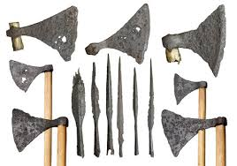
The Spread of Bantu Culture, cont.
With hard axes, they could cut down trees and clear the land.
Their sharp, iron-headed spears and arrows were powerful weapons for hunting and for warfare.
These migrations continued over many generations, with groups moving whenever an area became crowded.
In time, the Bantu had settled throughout Central and Southern Africa.

